Slide 1


Upgrade Now!
Hi, I am SIXT-AI! Do you want me to help you pick up your car?
Before you pick up your car: Upgrade to the BMW M5 now for just 29,99€! It includes all the features you could ever want.
Be quick or this offer will expire!
SIXT SENSE
DANGER! Upgrade to premium protection now or pay the price!
UPSELLING WITHOUT THE UPSELL
Upgrade Now!

Slide 2
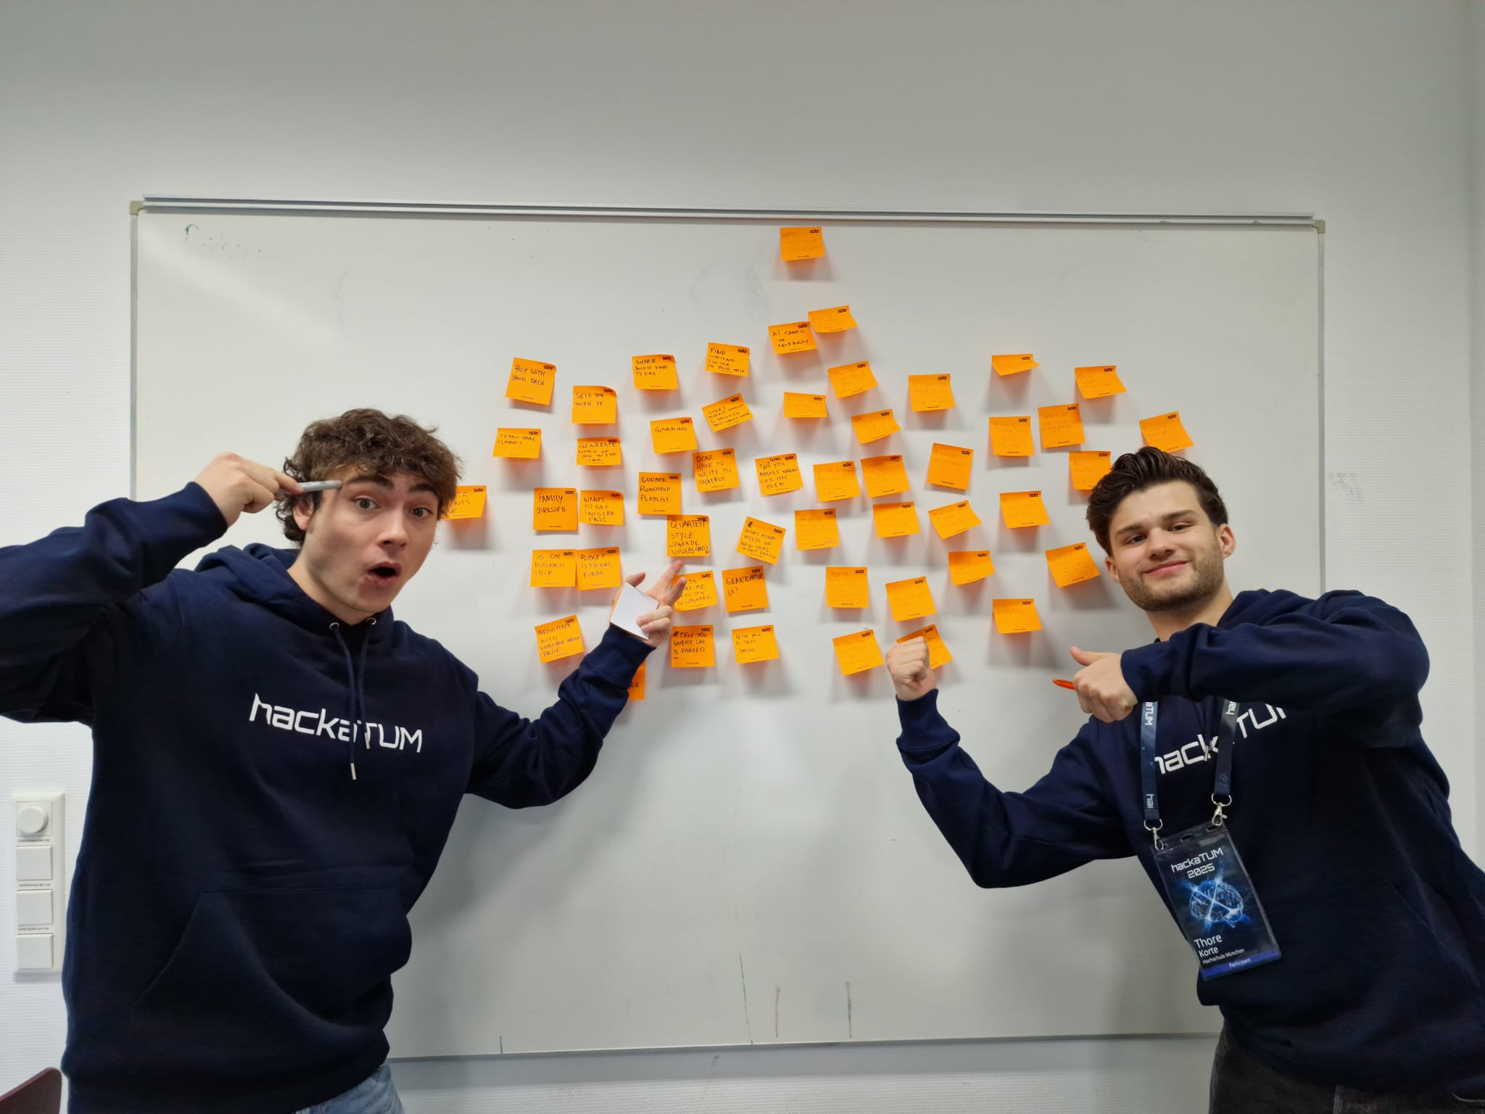
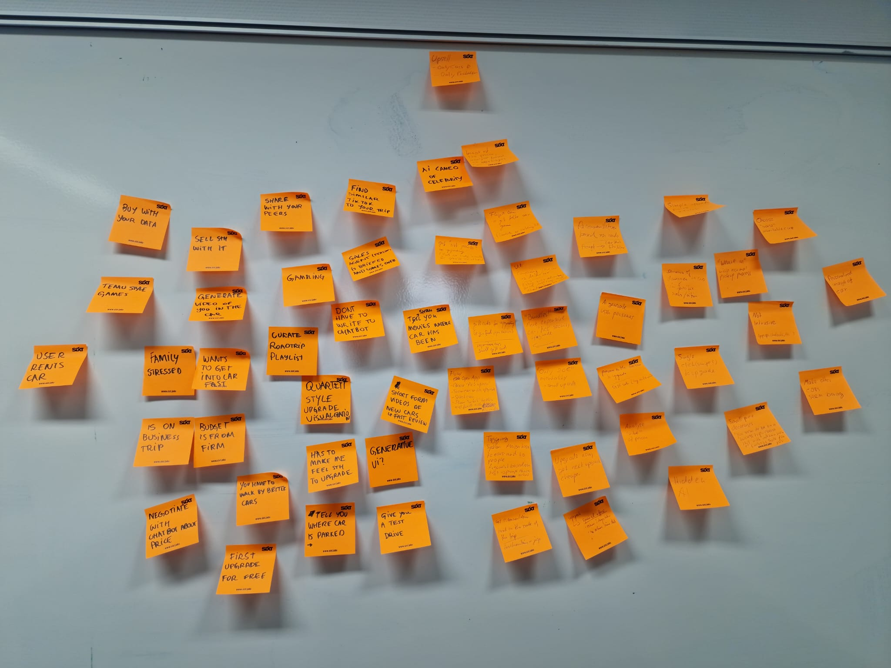
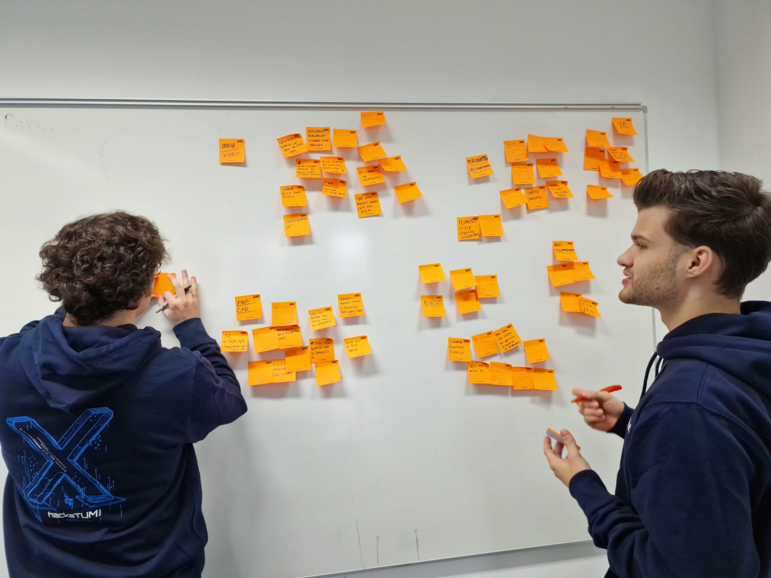
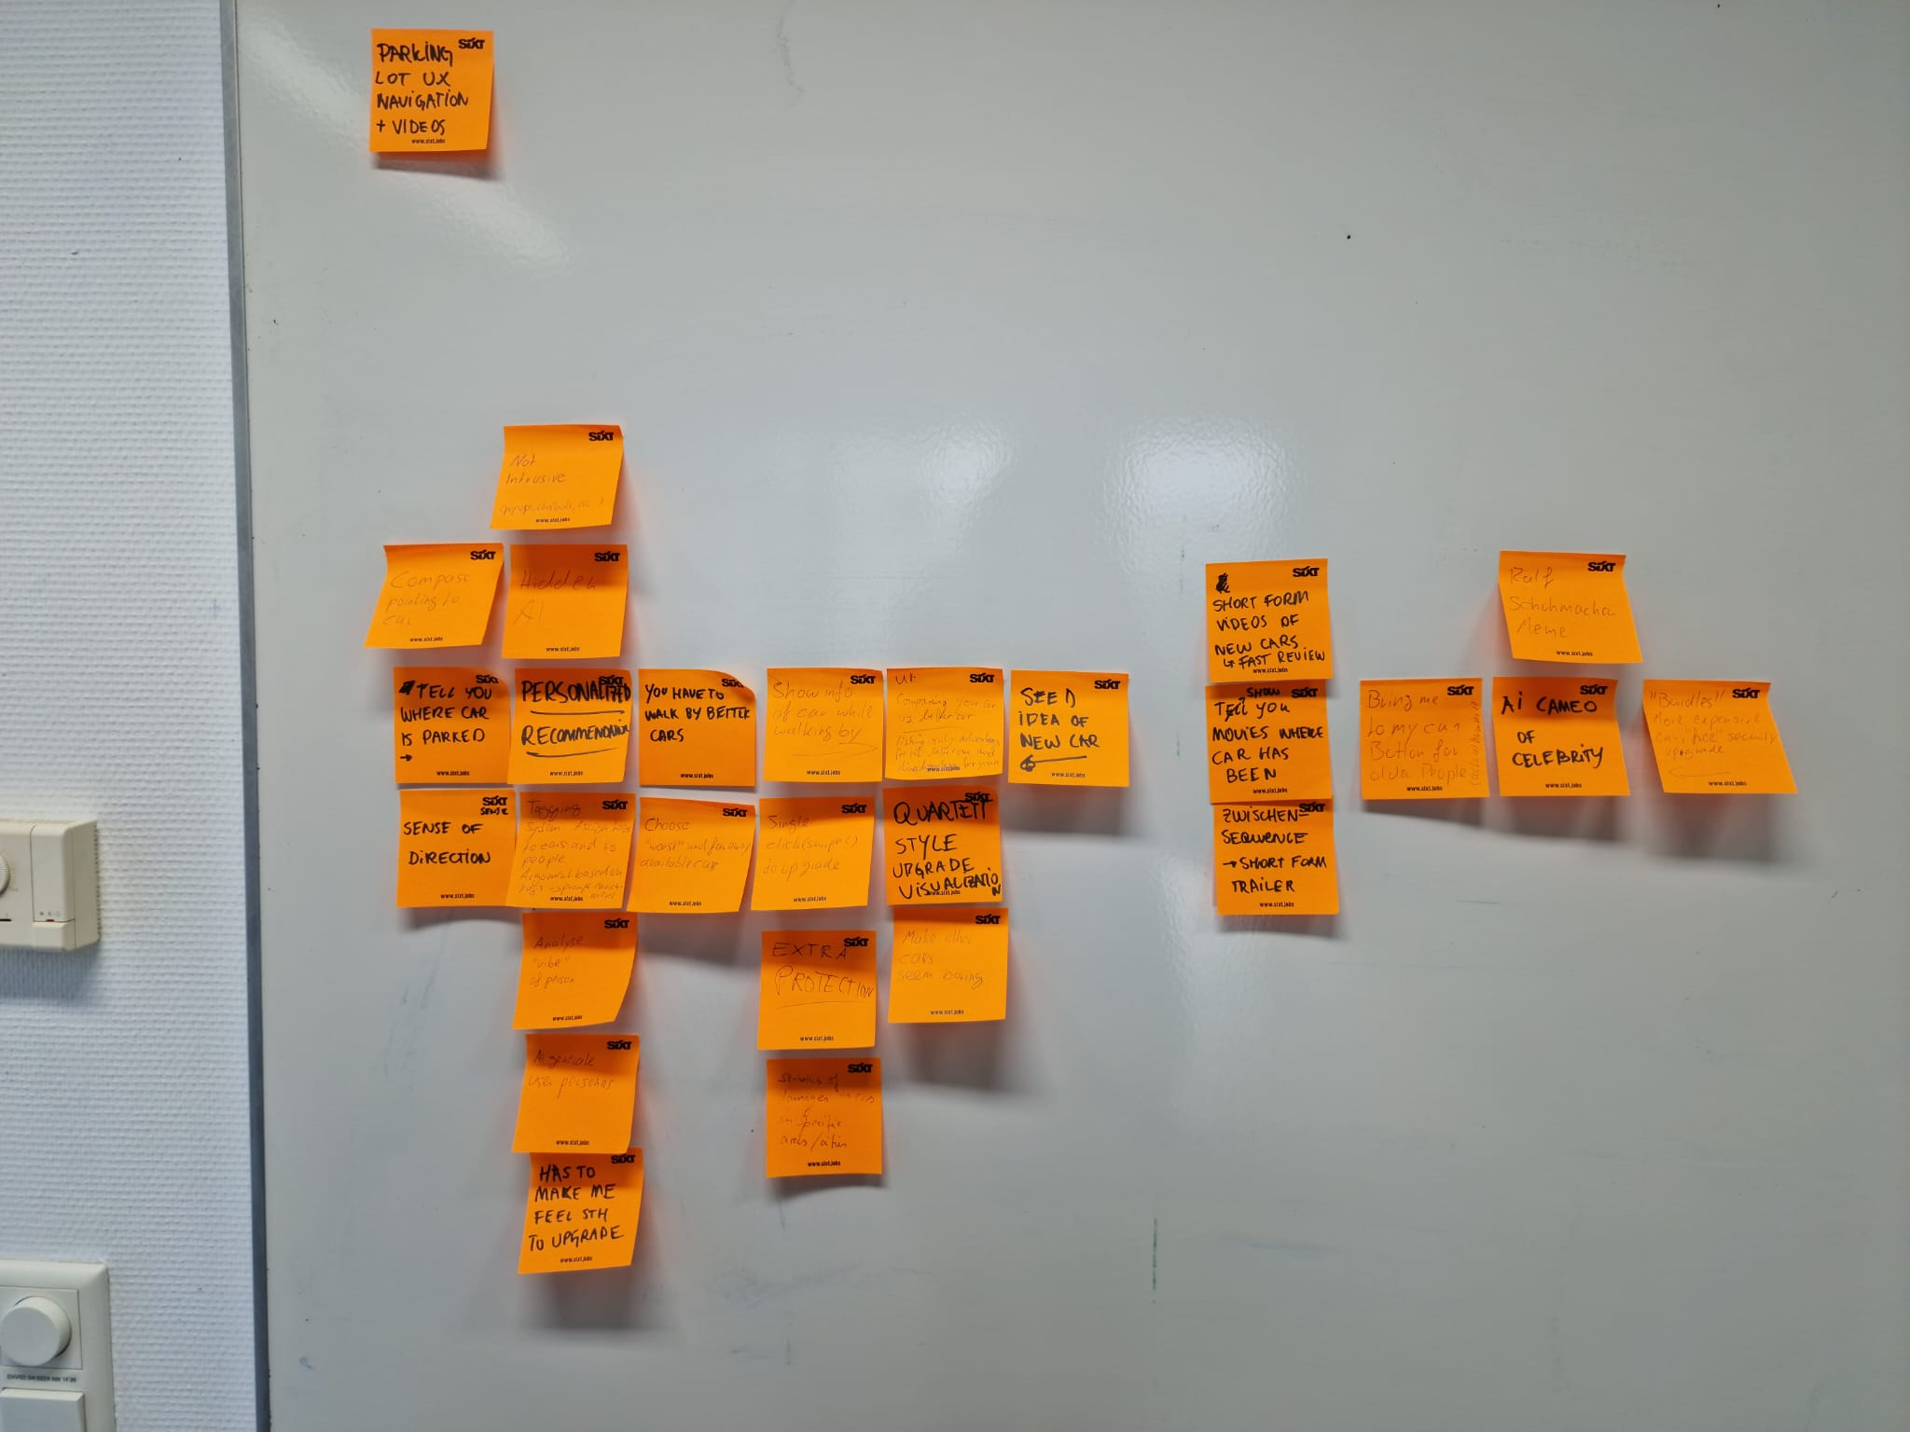
“How might we upsell through better design?”

Slide 3
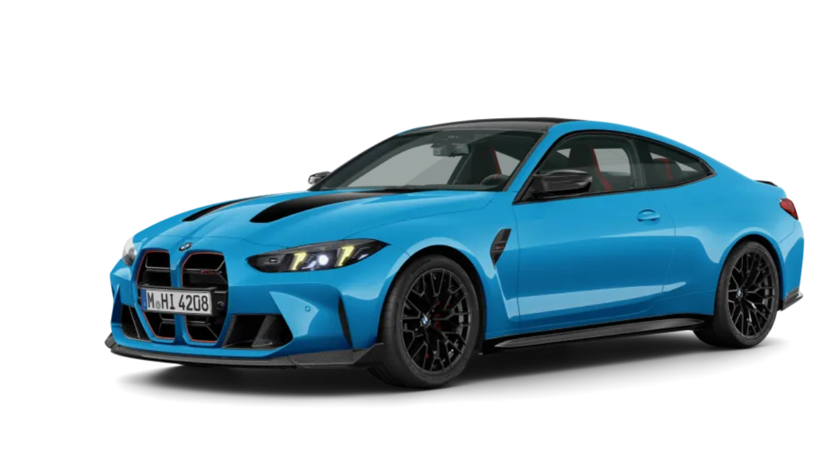
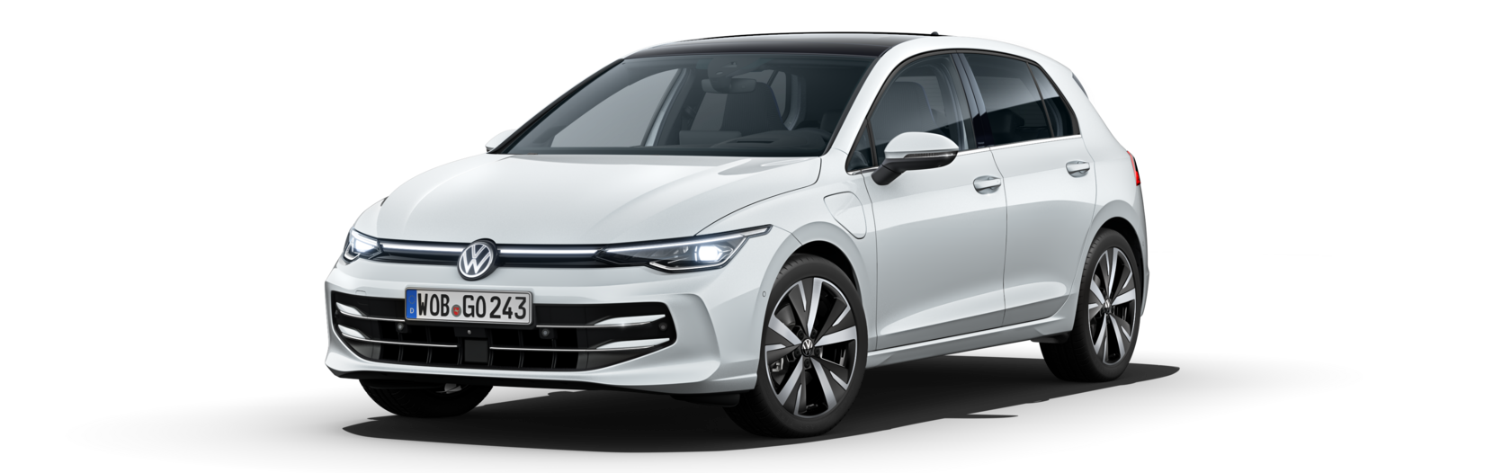


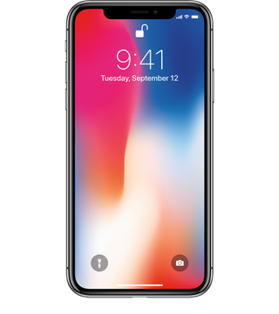

Idea
“just jump in”
booked car

Slide 4

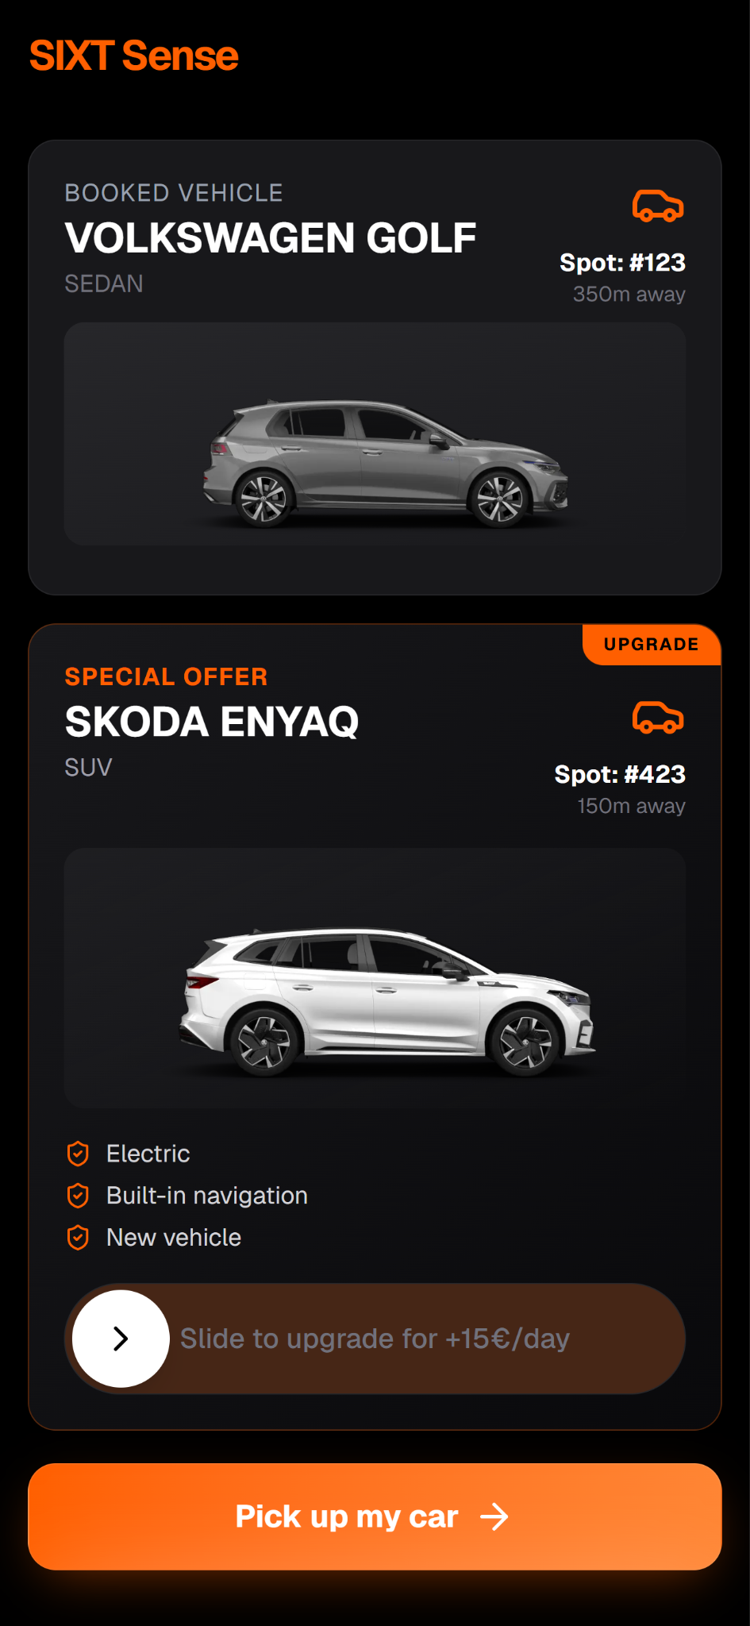
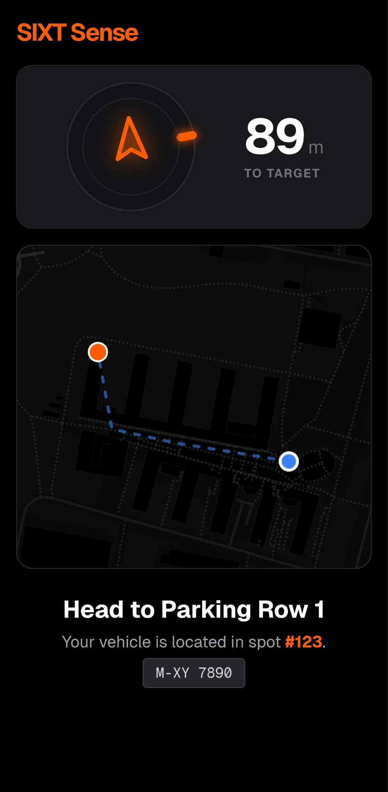
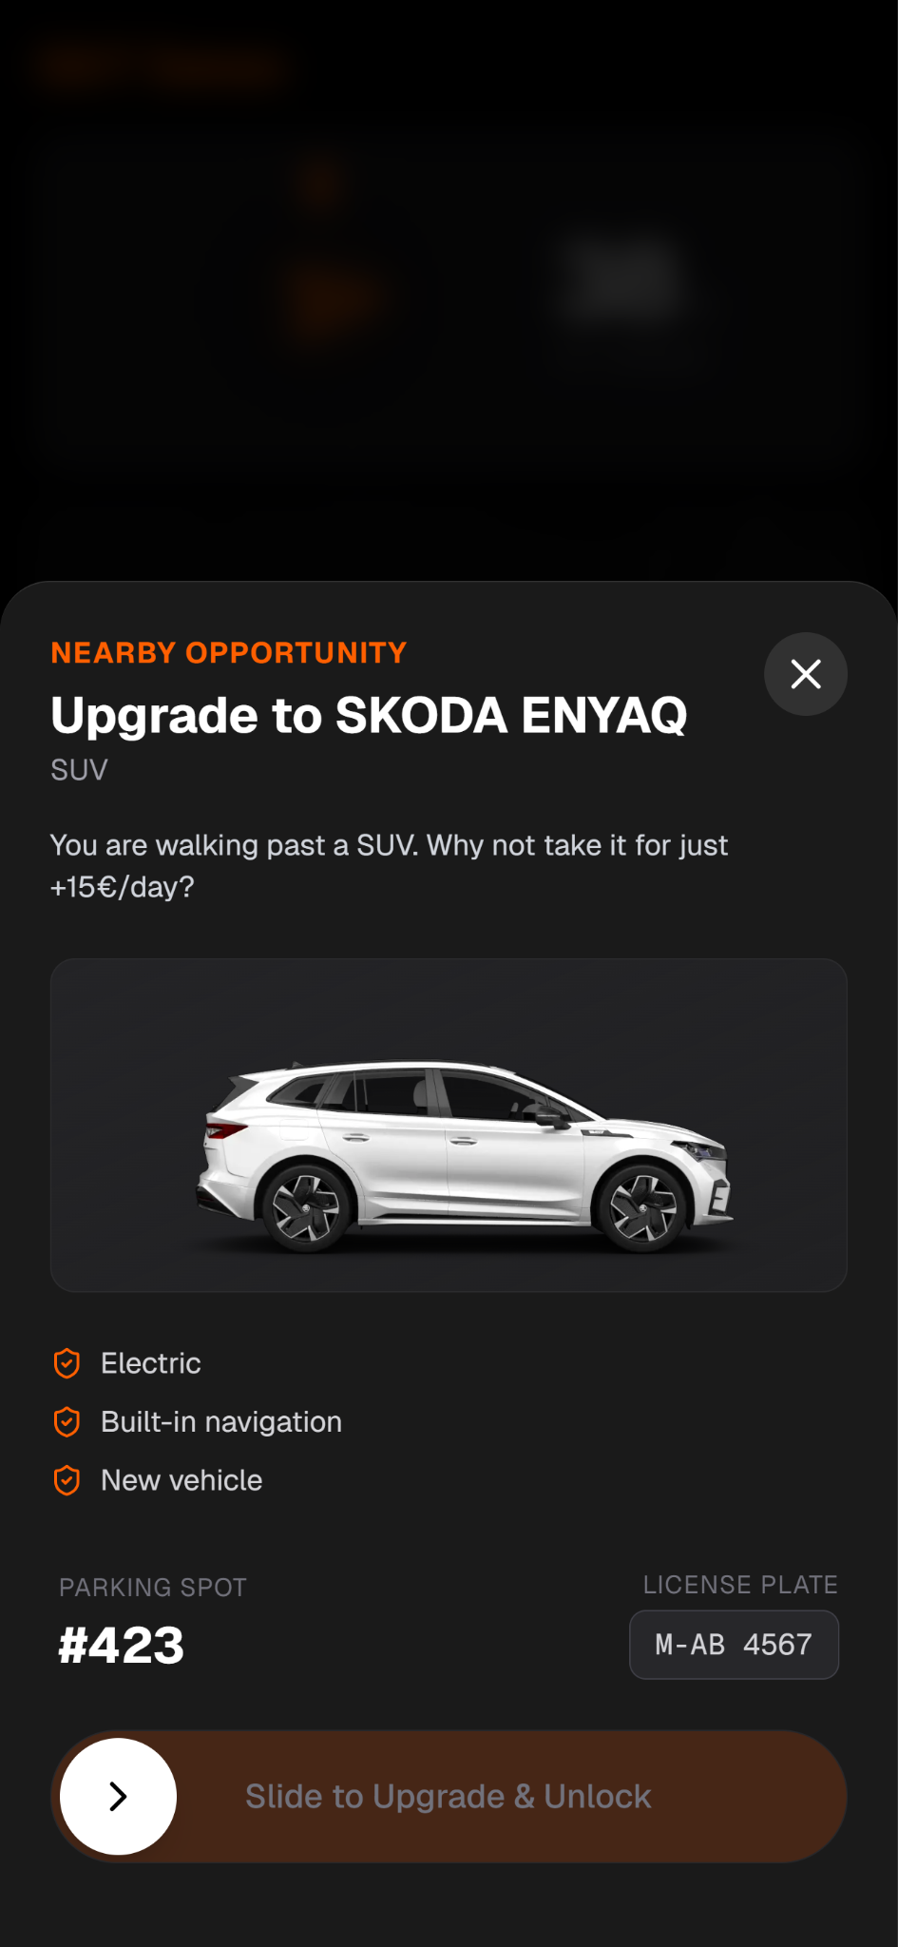
THE "DRIVE-BY" UPSELL

Slide 5

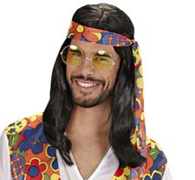
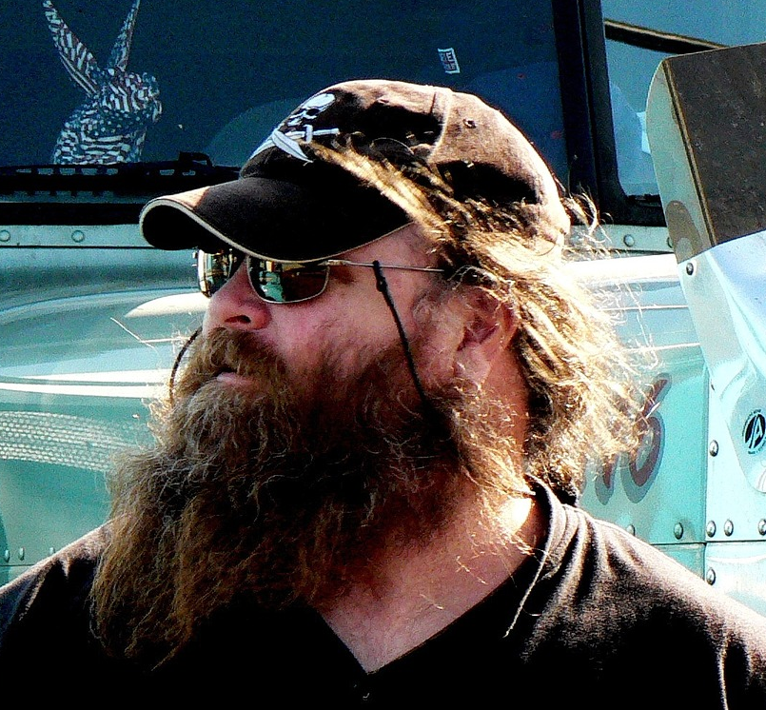


THE "VIBE" ENGINE
Fixed Algorithm
Explains
Tagging
Tagging
16 Personas
(+ Dynamic Endpoint)

Slide 6
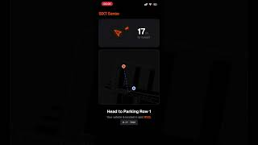
LIVE DEMO

Slide 7



FUTURE & IMPACT
IMPACT
VISION
Shift revenue from "booking annoyance" to "impulse upgrade."
GenAI Visualization: Render the car at the user's actual destination.
Higher conversion via physical proximity and convenience.
Smart Protect: Accident stats based on specific route data.
SIXT SENSE. DON'T JUST RENT. UPGRADE.

Slide 8
Do you hate intrusive ads?
Now you don’t have to anymore.

